Slide 1

Fake Consumer Review Detection C. Somers

Slide 2
Problem Overview
Ever increasing importance of e-commerce on our daily lives forces us to trust opinions of others.
93% of consumers say online reviews impact their purchasing decisions (Zhong-Gang et al., 2015).
This importance results in sellers falsifying reviews to try increase sales leading consumers into believing in dishonest product features or quality.
Humans are poor at discerning these false reviews however machines can do a much better job.

Slide 3
Methodology: Supervised Learning
Text Pre-processing
Feature Extraction
Classifier
Classified Review: Real Fake

Slide 4
Data
21,000 Amazon reviews labelled real or fake.
Balanced dataset (10,500 real vs 10,500 fake).
Balanced across 19 different categories.
Rating counts are varied.
Features:
Raw review text
Rating
Purchase verification
Category

Slide 5
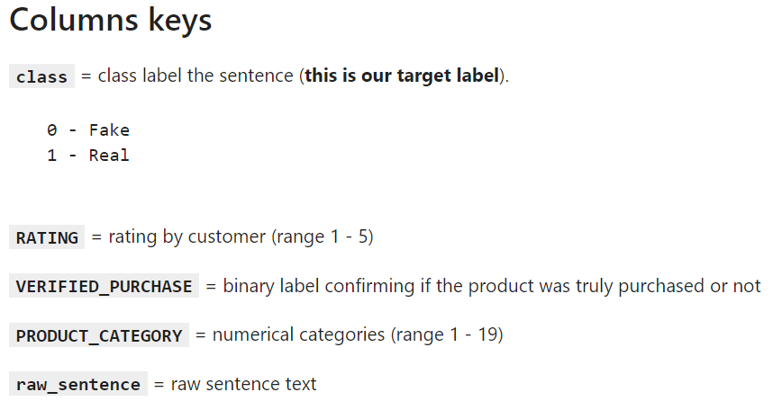
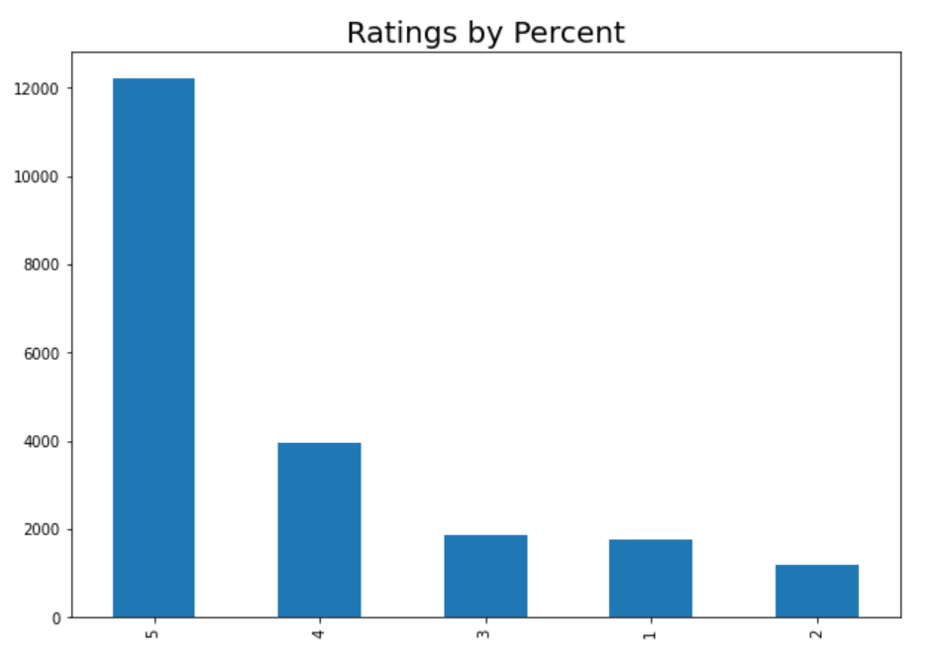
Data cont.

Slide 6
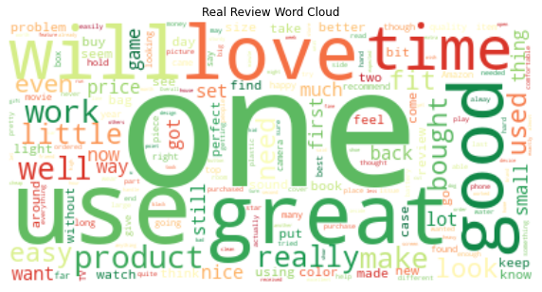
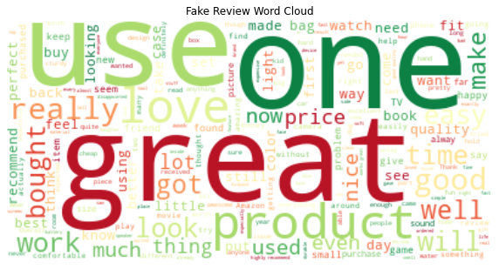
Exploratory Data Analysis
Note - Content of text shares overwhelming similarities to the human eye

Slide 7
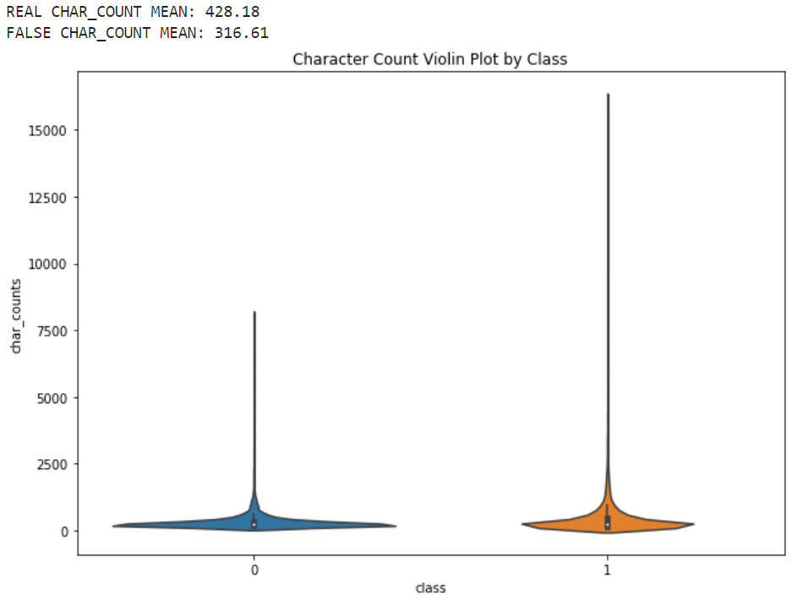
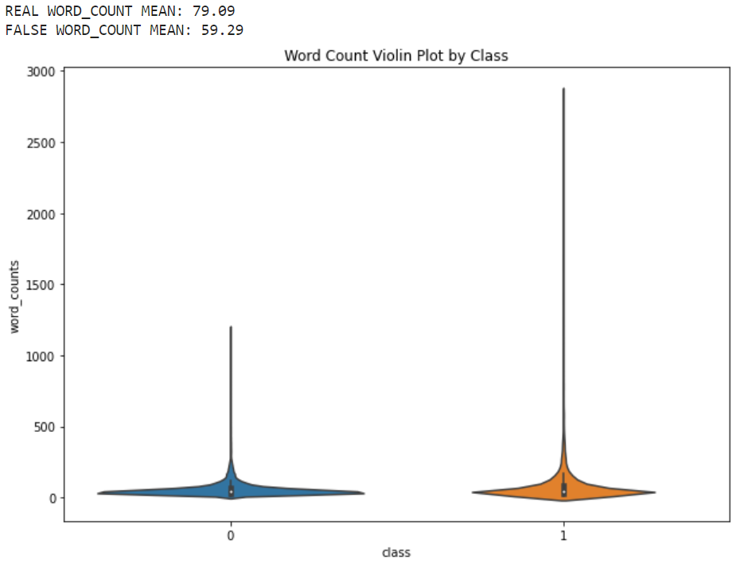
Exploratory Data Analysis
Note – Clear discrepancy between text structures of real and fake reviews

Slide 8
Feature Selection
Clear structural differences allowed me to employ structural NLP features in tandem with given features
Features for each review:
Category (Categorical)
Rating (Discrete)
Verified Purchase (Binary)
Word Count
Character Count
Unigrams
Bigrams

Slide 9

Model Evaluation
Scored model based on F1-Score as it balances the problem with missing fake reviews (customers mislead/unhappy) and falsely classifying fake reviews (accidental customer banning).
This is what I believe the best evaluation metric for the problem.
Due to strong base lightGBM scoring, hyperparametric optimization resulted in only a minor improvement in scoring (~81% F1).

Slide 10
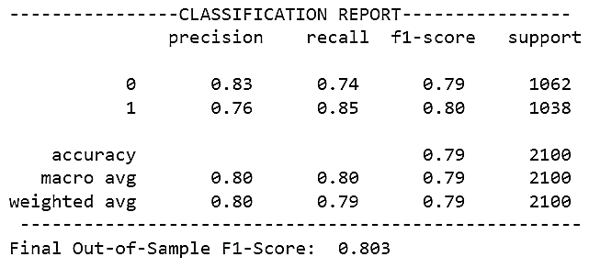
Model Evaluation Cont.
Out of Sample (Tuned) lightGBM Evaluation

Slide 11
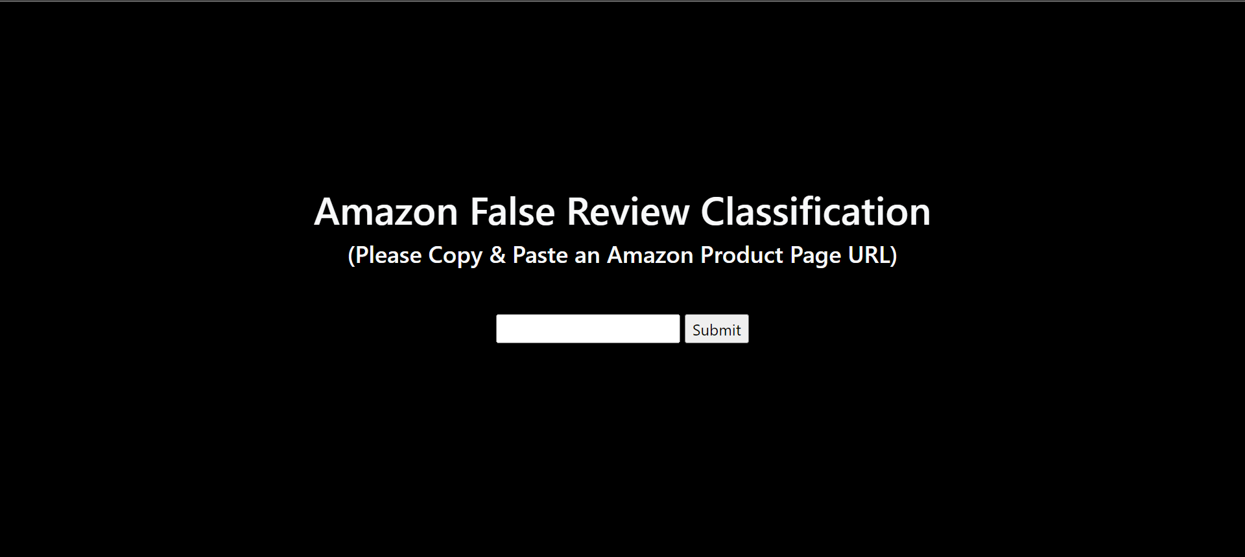
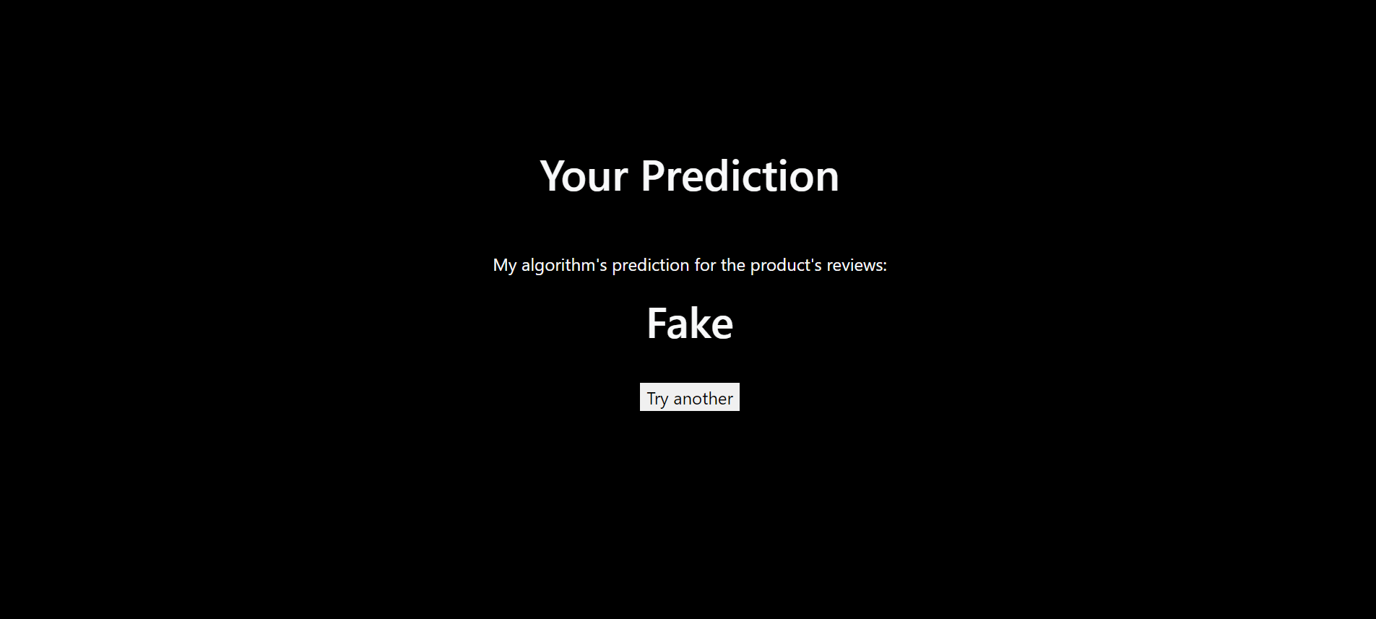
Deployment
Deployed using Flask.
Scrapes data from first-N pages of Amazon reviews.
Averages N-model estimates to determine the use of false reviews.

Slide 12

Thank you!
I hope this helps you uncover reviews you can trust.

